Slide 1
Discrete Mathematics (CSC 1204)
3.4 The Integers and Division
3.5 Primes and Greatest Common Divisors
3.8 Matrices

Slide 2
3.4 The Integers and Division
Definition 1: If a and b are integers with a≠0, we say that a divides b if there is an integer c such that b=ac. When a divides b we say that
a is a factor of b
b is a multiple of a
The notation a | b denotes that a divides b
We write a | b when a does not divide b

Slide 3
Example 1 (P.215)
Determine whether 3|7 and whether 3|12.
Solution:
It follows that 3|7, because 7/3 is not an integer.
On the other hand, 3|12 because 12/3 = 4

Slide 4
Integer Division: More Examples
Question: Which of the following is true?
77 | 7
7 | 77
24 | 24
0 | 24
24 | 0

Slide 5
More Examples
Answer:
77 | 7: false bigger number can’t divide
smaller positive number
7 | 77: true because 77 = 7 · 11
24 | 24: true because 24 = 24 · 1
0 | 24: false, only 0 is divisible by 0
24 | 0: true, 0 is divisible by every number (0 = 24 · 0)

Slide 6
Some basic properties of divisibility of Integers
Theorem 1: Let a, b, c be integers. Then (i) if a|b and a|c, then a|(b+c) (ii) if a|b, then a|bc for all integers c (iii) if a|b and b|c, then a|c
For example:
If 17|34 and 17|170, then 17|204
If 17|34, then 17|340
If 6|12 and 12|144, then 6 | 144

Slide 7
Some basic properties of divisibility of Integers
Corollary 1: If a, b, and c are integers such that a|b and a|c, then a|mb+nc whenever m and n are integers.

Slide 8
The Division Algorithm
Theorem 2: (The Division Algorithm) Let a be an integer and d a positive integer. Then there are unique integers q and r, with 0<=r<d,
such that a = dq + r
Definition 2: In the equality given in the division algorithm, d is called the divisor, a is called the dividend, q is called the quotient, and r is called the remainder. This notation is used to express the quotient and remainder: q = a div d, r = a mod d

Slide 9
Example 3 (p.216)
What are the quotient and remainder when 101 is divided by 11?
Solution: We have
101 = 11.9 + 2
Hence, the quotient when 101 is divided by 11 is 9 = 101 div 11, and the remainder is
2 = 101 mod 11

Slide 10
Example 4 (p.216)
What are the quotient and remainder when –11 is divided by 3?
Solution: we have, –11 = 3(–4) + 1
Hence, the quotient when –11 is divided by 3 is
–4 = –11 div 3, and the remainder is 1 = –11 mod 3
Remember, Remainder cannot be negative (since 0<=r<d )
So, the remainder is not –2, even though
–11 = 3(–3) –2, Because r = –2 does not satisfy 0 <=r < 3

Slide 11
Modular Arithmetic
Modular arithmetic is a system of arithmetic for integers, where numbers "wrap around" upon reaching a certain value—the modulus (plural moduli).
Modular arithmetic can be handled mathematically by introducing a congruence relation on the integers that is compatible with the operations on integers: addition, subtraction, and multiplication.
In some situations we care only about the remainder of an integer when it is divided by some specified positive integers.
A familiar use of modular arithmetic is in the 12-hour clock, in which the day is divided into two 12-hour periods. If the time is 7:00 now, then 8 hours later it will be 3:00. Usual addition would suggest that the later time should be 7 + 8 = 15, but this is not the answer because clock time "wraps around" every 12 hours. Because the hour number starts over after it reaches 12, this is arithmetic modulo 12. According to the definition below, 12 is congruent not only to 12 itself, but also to 0, so the time called "12:00" could also be called "0:00", since 12 is congruent to 0 modulo 12.

Slide 12
Applications of Modular Arithmetic
Generating pseudorandom numbers
Needed for computer simulation
Assigning computer memory locations to files
Hashing Functions
Cryptology
Encrypting and decrypting messages

Slide 13
Congruence : Formal Definition
DEF: If a and b are integers and m is a positive integer,
then a is congruent to b modulo m if m divides a –b.
We use the notation a ≡ b (mod m) to indicate that
a is congruent to b modulo m.
If a and b are not congruent modulo m, we write
a ≡ b (mod m)
Theorem 3: Let a and b be integers, and let m be a positive integer. Then
a ≡ b(mod m) iff a mod m = b mod m

Slide 14
Congruence
Question: Which of the following are true?
3 ≡ 3 (mod 17)
3 ≡ -3 (mod 17)
172 ≡ 177 (mod 5)
-13 ≡ 13 (mod 26)

Slide 15
Congruence
Answer:
3 ≡ 3 (mod 17) True. Any number is congruent to itself
(3-3 = 0, divisible by all)
2) 3 ≡ -3 (mod 17) False. (3-(-3)) = 6 isn’t divisible by 17.
3) 172 ≡ 177 (mod 5) True. 172-177 = -5 is a multiple of 5
4) -13 ≡ 13 (mod 26) True. -13 -13 = -26 divisible by 26.
Question: List five integers that are congruent to 3 modulo 7
Answer: 3, 10, 17, 24, 31

Slide 16
Cryptology
Cryptology is the study of secrete messages.
One of the earliest known uses of cryptology was by Julius Caesar.
He made messages secret by shifting each letter three letters forward in the alphabet. For instance, using this scheme the letter B is sent to E and the letter X is sent to A.
This is an example of encryption, that is the process of making a message secret.

Slide 17
Caesar Cipher
Mathematical expression:
f(p) = (p + 3) mod 26 0 ≤ p ≤ 25
Making messages secrets by shifting each letter three letters forward in the alphabet
B → E
X → A

Slide 18
Letter ←→ Number Conversion Table
A | B | C | D | E | F | G | H | I | J | K | L | M
0 | 1 | 2 | 3 | 4 | 5 | 6 | 7 | 8 | 9 | 10 | 11 | 12
N | O | P | Q | R | S | T | U | V | W | X | Y | Z
13 | 14 | 15 | 16 | 17 | 18 | 19 | 20 | 21 | 22 | 23 | 24 | 25

Slide 19
Example 9 @ p. 221
What is the secret message produced from the message “MEET YOU IN THE PARK” using the Caesar cipher?
Solution:
First replace the letters in the message with numbers. This produces
12 4 4 19 24 14 20 8 13 19 7 4 15 0 17 10
MEET = 12 4 4 19
YOU = 24 14 20
IN = 8 1 3
THE = 19 7 4
PARK = 15 0 17 10
Now replace each of these numbers p by f(p) = ( p + 3) mod 26. This produces
15 7 7 22 1 17 23 11 16 22 10 7 18 3 20 13
Translating this back to letters produces the encrypted message
“PHHW BRX LQ WKH SDUN”

Slide 20
Example 9 @ p. 221 [cont.]
To recover the original message from a secret message encrypted by the Caesar cipher, the function f ⁻¹, the inverse of f, is used.
The function f ⁻¹ sends an integer p from { 0, 1, 2, …25} to
f⁻¹ (p) = (p – 3) mod 26
In other words, to find the original message, each letter is shifted back three letters in the alphabet, with the first three letters sent to the last three letters of the alphabet.
The process of determining the original message from the encrypted message is called decryption.
Q: Decrypt the encrypted message “PHHW BRX LQ WKH SDUN” to the original message ( do it yourself)

Slide 21
Shift Cipher : Generalization of Caesar Cipher
There are various ways to generalize the Caesar cipher. For example, instead of shifting each letter by 3,
we can shift each letter by k, so that
f(p) = (p + k) mod 26
Such a cipher is called a shift cipher.
The decryption can be carried out using
f⁻¹ (p) = (p – k) mod 26

Slide 22
Exercise 31(b) @ p. 222-223 Example of Shift cipher
Encrypt the message “DO NOT PASS GO” by translating the letters into numbers, applying the encryption function given, and then translating the numbers back into letters.
f(p) = (p + 13) mod 26
Solution: ( Answer is in your book! )
Try it yourself first. Then SEE next slide for solution.

Slide 23
Solution of Exercise 31(b)
The message in number is –
3-14 13-14-19 15-0-18-18 6-14
Replacing each of these numbers p by f(p) = ( p + 13) mod 26
produces
16-1 0-1-6 2-13-5-5 19-1
Translating this back into letter produces the encrypted message
“QB ABG CNFF TB”

Slide 24
3.5 Primes and Greatest Common Divisors

Slide 25
Primes
Definition 1: A positive integer p greater than 1 is called prime if the only positive factors of p are 1 and p. A positive integer that is greater than 1 and is not prime is called composite.
The integer n is composite iff there exists an integer a such that a|n and 1<a<n
Theorem 3: There are infinitely many primes.

Slide 26
Primes
Example 1 (p.223): The integer 7 is prime because its only positive factors are 1 and 7, whereas the integer 9 is composite because it is divisible by 3.
Question: What are the primes less than 100?

Slide 27
Fundamental Theorem of Arithmetic
Theorem 1(Fundamental Theorem of Arithmetic): Every positive integer greater than 1 can be written uniquely as a prime or as the product of two or more primes where the prime factors are written in order of non-decreasing size.
Example 2 (p.224) : Prime factorization of 100, 641, 999, and 1024 are given by
100 = 2.2.5.5 = 2².5²
641 = 641
999 = 3.3.3.37 = 3³.37
1024 = 2.2.2.2.2.2.2.2.2.2 = 2¹⁰

Slide 28
Determining whether a given integer is Prime
Theorem 2: If n is a composite integer, then n has a prime divisor less than or equal to √n.

Slide 29
Determining whether a given integer is Prime
Example 3 [p.224]: Show that 101 is prime.
Solution: The only primes not exceeding √101 are 2, 3, 5, 7. Because 101 is not divisible by 2, 3, 5, or 7, it follows that 101 is prime.
Exercise 1(e)[p.230]: Determine whether 111 is prime.
Solution: The only primes not exceeding √111 are 2, 3, 5, 7. Because 111 is divisible by 3, it follows that 111 is not prime.
Exercise 1(f)[p.230]: Determine whether 143 is prime.
Solution: The only primes not exceeding √143 are 2, 3, 5, 7,11. Because 143 is divisible by 11, it follows that 143 is not prime.
Extra example: Test if 139 is prime.

Slide 30
Greatest Common Divisor(gcd)
Definition 2: Let a and b be integers, not both zero. The largest integer d such that d|a and d|b is called the greatest common divisor of a and b.
The greatest common divisor of a and b is denoted by gcd(a, b)
Example 10 (p.228): What is the greatest common divisor of 24 and 36?
Solution: The positive common divisors of 24 and 36 are 1, 2, 3, 4, 6, and 12. Hence gcd(24,36) = 12

Slide 31
Relatively Prime
Definition 3: The integers a and b are relatively prime if their gcd is 1.
Example 11 (p.228): What is the gcd of 17 and 22?
Solution: The integers 17 and 22 have no positive common divisors other than 1, so that gcd(17,22) = 1
By Example 11, it follows that the integers 17 & 22 are relatively prime, because gcd(17,22) = 1

Slide 32
Finding gcd & lcm using Prime Factorization
Another way to find the greatest common divisor of two integers is to use the prime factorization of these integers.
Let prime factorization of the integers a and b, neither equal to zero, are a = p₁^{a1} p₂^{a2} ….. p_{n}ª _{n} ,
b = p₁^{b1} p₂^{b2} …... p_{n}^{b} _{n}
gcd(a,b) = p₁^{min(a1,b1)} p₂^{min(a2,b2)} ………p_{n}^{min(an , bn)}
Note: Prime factorization can also be used to find the least common multiple(lcm) of two integers
lcm(a,b) = p₁^{max(a1,b1)} p₂^{max(a2,b2) ………}p_{n}^{max(an , bn)}

Slide 33
Least Common Multiple(lcm)
Definition 5: The least common multiple of positive integers a and b is the smallest positive integer that is divisible by both a and b.
The least common multiple of a and b is denoted by
lcm(a, b)
Theorem 5: Let a and b be positive integers. Then ab = gcd(a,b) . lcm(a,b)

Slide 34
Finding gcd & lcm : Examples
Example 14(p.229): What is the gcd of 120 and 500?
Solution: Because the prime factorization of 120 and 500 are 120 = 2³.3.5 and 500 = 2².5³ , the greatest common divisor is
gcd(120,500) = 2^{min(3,2)} 3^{min(1,0)} 5^{min(1,3)}
= 2² 3⁰ 5¹
= 20
[Note: 500 = 2². 3⁰.5³ ]
Question: Find the lcm(120,500), and then prove the theorem
ab = gcd(a,b) . lcm(a,b) , where a =120, and b = 500

Slide 35
Finding gcd & lcm : Examples
Example 15(p.230): What is the least common multiple(lcm) of 2³3⁵7² and 2⁴3³?
Solution:
lcm (2³3⁵7² , 2⁴3³⁾ = 2^{max(3,4)}3^{max(5,3)}7^{max(2,0)}
= 2⁴3⁵7²
[Note: 7⁰ = 1]

Slide 36
3.8 Matrices

Slide 37
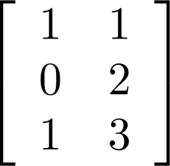
Matrix
Definition 1: A matrix is a rectangular array of numbers. A matrix with m rows and n columns is called an m× n matrix.
The plural of matrix is matrices
A matrix with the same number of rows as columns is called a square (or square matrix)
Two matrices are equal if they have the same number of rows and the same number of columns and the corresponding entries in every position are equal.
is a 3× 2 matrix

Slide 38
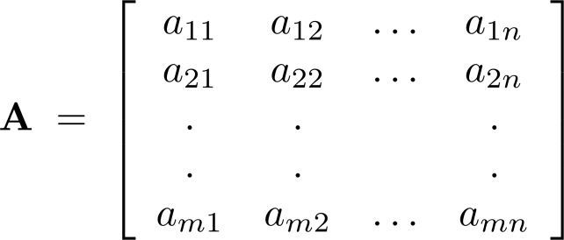
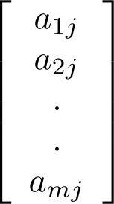
Notation
Let m and n be positive integers and let
The ith row of A is the 1× n matrix [a_{i1}, a_{i2},…,a_{in}]. The jth column of A is the m× 1 matrix:
The (i,j)th element or entry of A is the element a_{ij}.
We can use A = [a_{ij} ] to denote the matrix with its (i,j)th element equal to a_{ij}.

Slide 39
Matrix Arithmetic : Addition of two Matrices
Definition 3: Let A= [a_{ij}] and B=[b_{ij}] be m×n matrices. The sum of A and B, denoted by A+B, is the m×n matrix that has a_{ij}+b_{ij} as its (i,j)th element.
In other words , A + B = [a_{ij} + b_{ij}]

Slide 40
Matrix Arithmetic: Addition of two Matrices
The sum of two matrices of the same size is obtained by adding elements in the corresponding positions.
The subtraction of two matrices of the same size is obtained by subtracting elements in the corresponding positions
Only matrices with the same dimensions can be added and subtracted. The resulting matrix has the same dimension of the two matrices being added or subtracted.
Note: Matrices of different sizes cannot be added/subtracted

Slide 41
Example of Matrix Addition
Add the corresponding elements in each matrix

Slide 42
Example of Matrix Addition: Example 2 (p.258)
Find out the sum of the following two matrices A and B.

Slide 43
Example of Matrix Addition: Example 2 (p.258)
Solution:

Slide 44
Matrix Arithmetic: Product of two Matrices
Definition 4: Let A be m× k matrix and B be k× n matrix. The product of A and B, denoted by AB, is the m× n matrix with its (i,j)th element equal to the sum of the products of the corresponding entries from the ith row of A and the jth column of B.
In other words,
If AB = [c_{ij}], then c_{ij} =a_{i1}b_{1j}+a_{i2}b_{2j}+…+a_{ik}b_{kj}.
Note: A product of two matrices is defined only when the number of columns in the first matrix equals the number of rows of the second matrix.

Slide 45
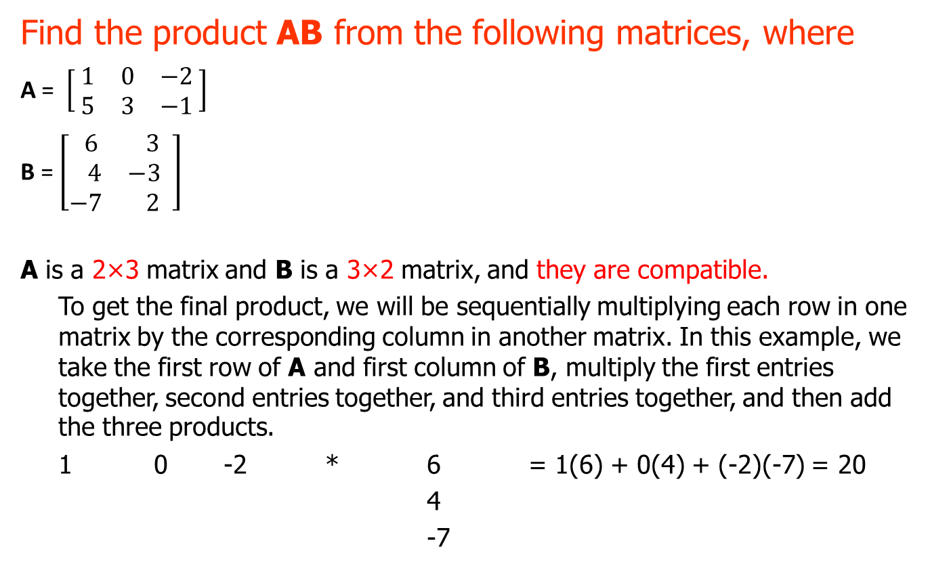
Product of two Matrices: Example
Find the product AB from the following matrices, where
A = $\left[\begin{matrix} 1 & 0 & −2 \\ 5 & 3 & −1\end{matrix} \right]$
B = $\left[\begin{matrix} 6 & 3 \\ 4 & −3 \\ −7 & 2\end{matrix} \right]$
A is a 2×3 matrix and B is a 3×2 matrix, and they are compatible.
To get the final product, we will be sequentially multiplying each row in one matrix by the corresponding column in another matrix. In this example, we take the first row of A and first column of B, multiply the first entries together, second entries together, and third entries together, and then add the three products.
1 0 -2 * 6 = 1(6) + 0(4) + (-2)(-7) = 20
4
-7

Slide 46
This sum is one of the entries in the product matrix AB; in fact, being the product
of row 1 of A and column 1 of B, it is the (1,1)-entry in AB.
Column 1
↓
Row 1 → 20 #
# #
Then we continue in like manner; we multiply row 1 of A by column 2 of B.
1 0 -2 * 3 = 1(3) + 0(-3) + (-2)(2) = -1
-3
2
And its position in matrix AB is
Column 2
↓
20 -1 ← Row 1
# #

Slide 47
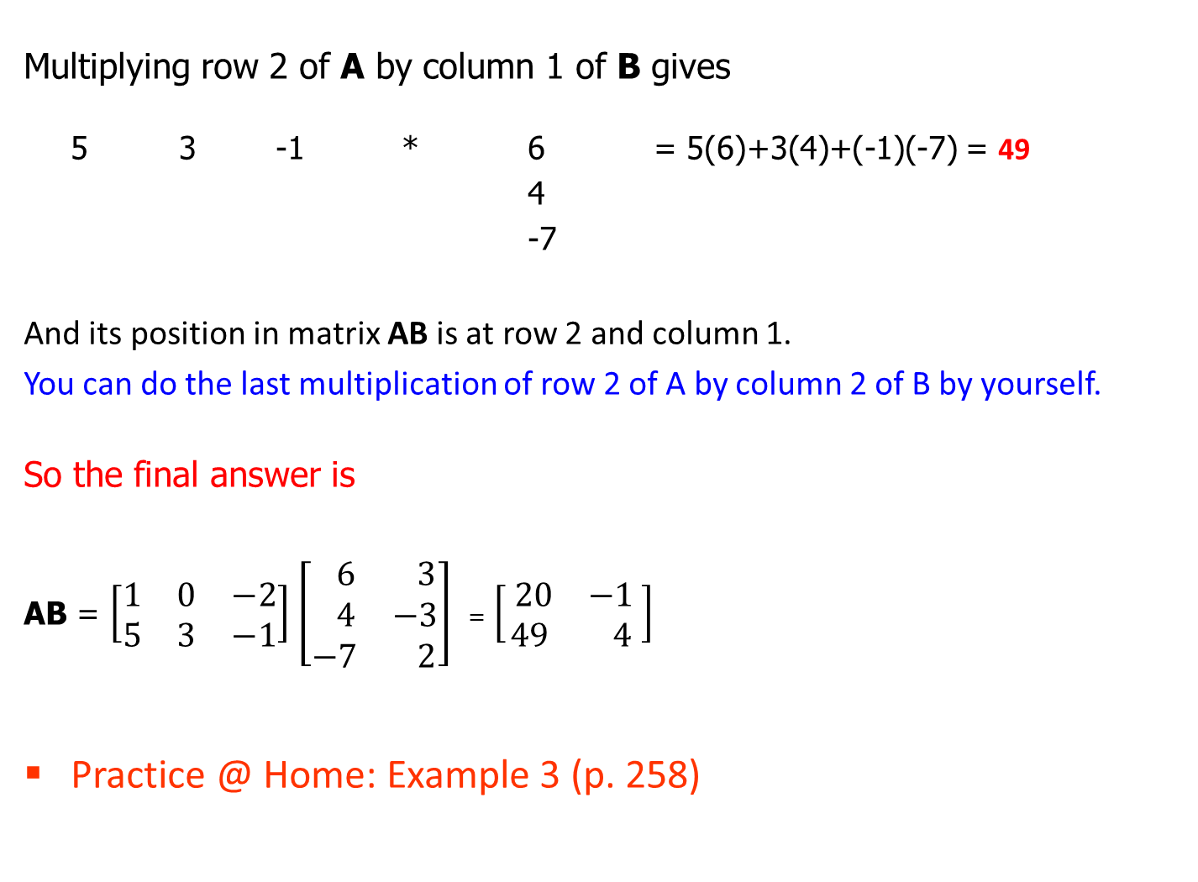
Multiplying row 2 of A by column 1 of B gives
5 3 -1 * 6 = 5(6)+3(4)+(-1)(-7) = 49
4
-7
And its position in matrix AB is at row 2 and column 1.
You can do the last multiplication of row 2 of A by column 2 of B by yourself.
So the final answer is
AB = $\left[\begin{matrix}1 & 0 & −2 \\ 5 & 3 & −1\end{matrix}\right]$ $\left[\begin{matrix} 6 & 3 \\ 4 & −3 \\ −7 & 2\end{matrix}\right]$ = $\left[\begin{matrix} 20 & −1 \\ 49 & 4\end{matrix}\right]$
Practice @ Home: Example 3 (p. 258)

Slide 48
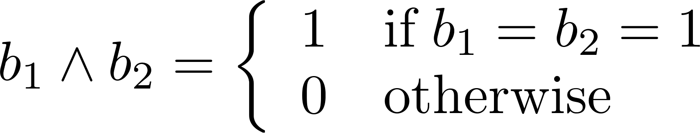
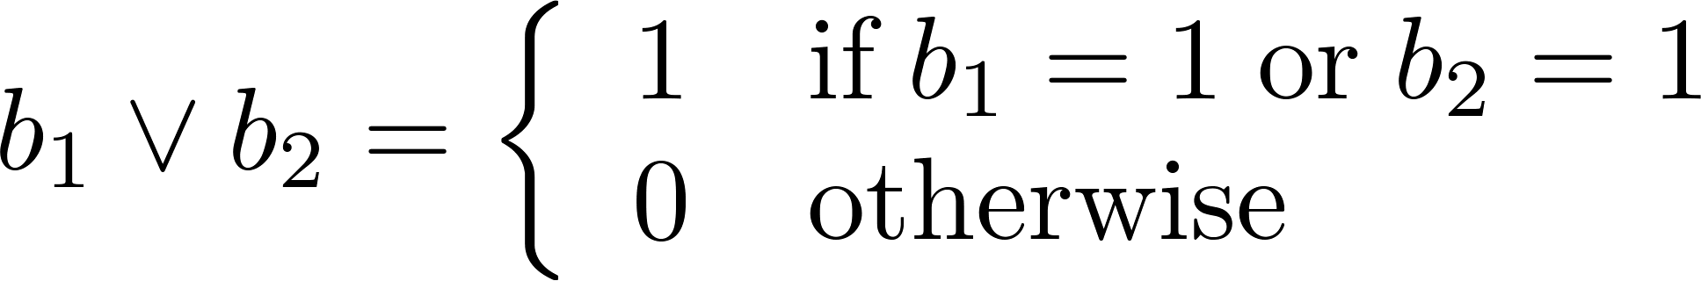
Zero-One Matrices
Definition: A matrix with entries that are either 0 or 1 is called zero-one matrix.
Algorithms operating on discrete structures represented by zero-one matrices are based on Boolean arithmetic defined by the following Boolean operations:

Slide 49
Join and Meet of Zero-One Matrices
Definition: Let A = [a_{ij}] and B = [b_{ij}] be an m × n zero-one matrices.
The join of A and B is the zero-one matrix with (i,j)th entry a_{ij} ∨ b_{ij}. The join of A and B is denoted by A ∨ B.
The meet of A and B is the zero-one matrix with (i,j)th entry a_{ij} ∧ b_{ij}. The meet of A and B is denoted by A ∧ B.
Note: These operations(join and meet) are only possible when A and B have the same size, just as in the case of matrix addition.

Slide 50
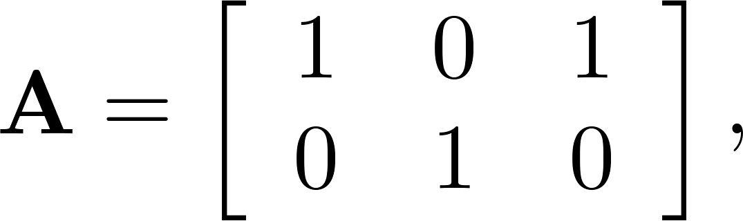
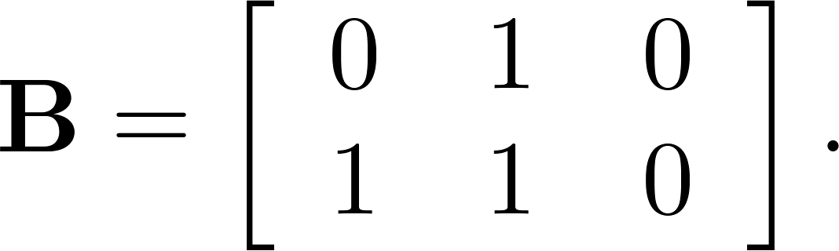
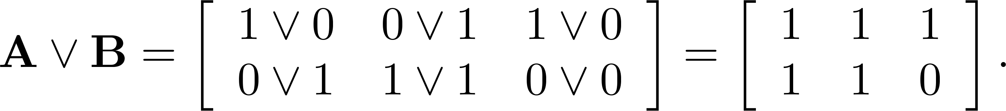
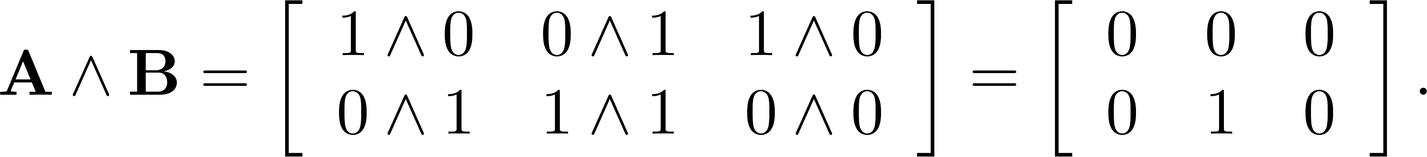
Join and Meet of Zero-One Matrices: Example
Example 9 (p. 262): Find the join and meet of the zero-one
matrices A and B.
Solution: The join of A and B is
The meet of A and B is

Slide 51
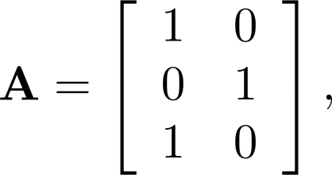
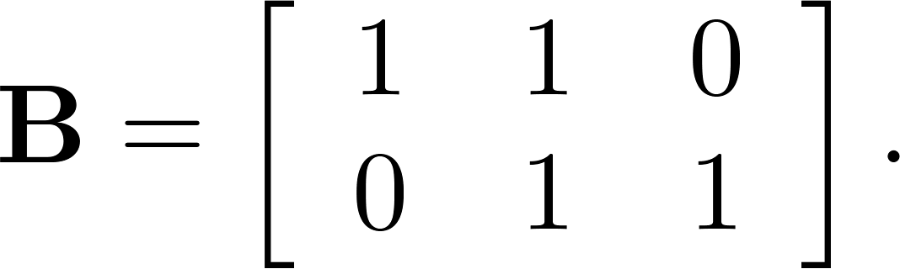
Boolean Product of Zero-One Matrices
Definition: Let A = [a_{ij}] be an m× k zero-one matrix and
B = [b_{ij}] be a k× n zero-one matrix.
The Boolean product of A and B, denoted by A ⊙ B, is
the m× n zero-one matrix with(i,j)th entry c_{ij} where c_{ij} = (a_{i1} ∧ b_{1j})∨ (a_{i2} ∧ b_{2j}) ∨ … ∨ (a_{ik} ∧ b_{kj})
Example 9 (p.262): Find the Boolean product of A and
B, where

Slide 52
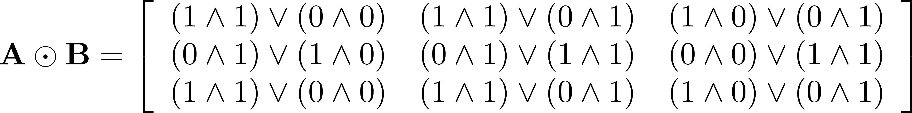
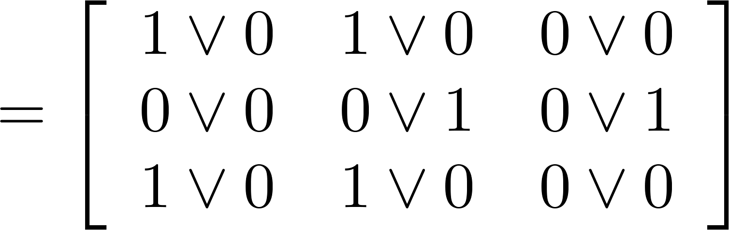
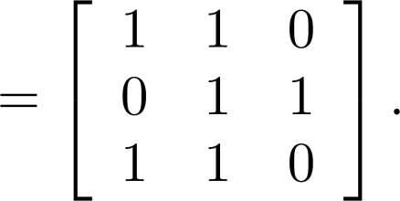
Solution of Example 9 (p.262)
The Boolean product A ⊙ B is given by

Slide 53
Practice @ Home
Relevant Odd-Numbered Exercises

